Slide 1
Introduction to Windows Azure
Mike Long
Technology Specialist, Windows Azure

Slide 2
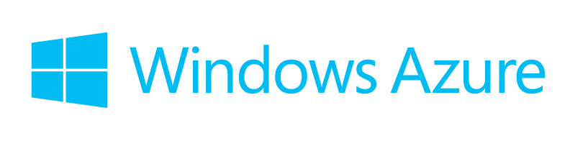
Agenda
Microsoft in the Cloud
How can I use the Cloud?
My Datacenter and the Cloud
Cloud integrated Storage
Getting Started
Notes:
Key Points:
The Cloud is Here – this is what it’s all about:
Attributes: Pooled Resources, Self Service, Elastic, Usage Based
Benefits: Focus, Agility, Economics
Talk Track:
Today, cloud computing is changing the very definition of IT. And so the conversation needs to change as well. Yesterday, the conversation was about consolidation and cost. Today, the conversation is about the new breed of benefits that cloud computing delivers. It’s all about transforming the way IT serves your business by harnessing a new breed of power. Microsoft is the only company that brings all of the pieces together in an integrated, comprehensive way. With our long-term vision to change the world through computing, we help every customer transform the datacenter of today into the private cloud of tomorrow, with a pathway to the public cloud and beyond.
With that said – cloud computing is the on-demand delivery of applications as standardized IT services, and inherently has four key attributes:
Pooled Resources: As I mentioned earlier, we often hear that cloud computing is just big virt. It’s not. Cloud Computing uses virtualization but it adds significantly to virtualization. It pools those resources together and allows you to dynamically provision and scale applications.
Self Service: Once you pool your resource, Cloud Computing provides a self service way for the business to get at those resources or more specifically by providing self-service IT infrastructure to business units and departments with an SLA. This forces service-level discussion and removes the burden to procure, provision and manage infrastructure on a per application, ad-hoc basis
Elastic – Scale up (or scale down) dynamically as resource needs change, enabling faster delivery of capacity.
Usage Based – Paying for only what you use, when you need to use it
I am sure just hearing the attributes the benefits are crystalizing for each of you but I do want to spend a few minutes talking about the biggest benefits from our perspective:
Focus: This is about having more people able to focus on higher-level parts of the stack, managing those applications SLAs, rolling out new applications, not having to worry about the underlying infrastructure
Agility: This is not only about being able to deliver the applications more quickly to your users and to your customers, but also being able to respond to changes in demand. So, the next time the marketing department launches a campaign, doesn't tell anybody, your public website is underwater, it's very easy to scale that out quickly to meet that demand.
Economics: Because you're running multiple workloads on the same overall infrastructure, you get better utilization across those applications. And because the Cloud pools together these resources, you can buy broader sets of resources at one time, lowering the overall cost. So, for agility and focus and economics, you have great motivation to move to the Cloud, and those benefits accrue to both public and to private Cloud Computing.

Slide 3



Today’s Transformation – Cloud
Pooled Resources
Self-Service
Elastic
Usage Based
Economics ▪ Agility ▪ Focus
Notes:
Key Points:
The Cloud is Here – this is what it’s all about:
Attributes: Pooled Resources, Self Service, Elastic, Usage Based
Benefits: Focus, Agility, Economics
Talk Track:
Today, cloud computing is changing the very definition of IT. And so the conversation needs to change as well. Yesterday, the conversation was about consolidation and cost. Today, the conversation is about the new breed of benefits that cloud computing delivers. It’s all about transforming the way IT serves your business by harnessing a new breed of power. Microsoft is the only company that brings all of the pieces together in an integrated, comprehensive way. With our long-term vision to change the world through computing, we help every customer transform the datacenter of today into the private cloud of tomorrow, with a pathway to the public cloud and beyond.
With that said – cloud computing is the on-demand delivery of applications as standardized IT services, and inherently has four key attributes:
Pooled Resources: As I mentioned earlier, we often hear that cloud computing is just big virt. It’s not. Cloud Computing uses virtualization but it adds significantly to virtualization. It pools those resources together and allows you to dynamically provision and scale applications.
Self Service: Once you pool your resource, Cloud Computing provides a self service way for the business to get at those resources or more specifically by providing self-service IT infrastructure to business units and departments with an SLA. This forces service-level discussion and removes the burden to procure, provision and manage infrastructure on a per application, ad-hoc basis
Elastic – Scale up (or scale down) dynamically as resource needs change, enabling faster delivery of capacity.
Usage Based – Paying for only what you use, when you need to use it
I am sure just hearing the attributes the benefits are crystalizing for each of you but I do want to spend a few minutes talking about the biggest benefits from our perspective:
Focus: This is about having more people able to focus on higher-level parts of the stack, managing those applications SLAs, rolling out new applications, not having to worry about the underlying infrastructure
Agility: This is not only about being able to deliver the applications more quickly to your users and to your customers, but also being able to respond to changes in demand. So, the next time the marketing department launches a campaign, doesn't tell anybody, your public website is underwater, it's very easy to scale that out quickly to meet that demand.
Economics: Because you're running multiple workloads on the same overall infrastructure, you get better utilization across those applications. And because the Cloud pools together these resources, you can buy broader sets of resources at one time, lowering the overall cost. So, for agility and focus and economics, you have great motivation to move to the Cloud, and those benefits accrue to both public and to private Cloud Computing.

Slide 4





IT Continuum
Evolution toward highly-virtual and beyond to cloud
Physical
Virtual / Private
IaaS
PaaS
SaaS
Notes:
First let’s talk about the transformation that's actually happening within IT.
Goal of this slide
Frames the enterprise cloud computing conversation by highlighting the evolution from traditional to cloud computing models. Define industry taxonomy around IaaS and PaaS.
Talking Points:
If you're in the infrastructure as a service layer (IaaS), you're thinking about your datacenter as a set of pooled virtual resources (including compute, network and storage), not in terms of individual hosts or VMs. That said, you still have to manage the virtual infrastructure, operating system and the full application stack.
When you're in the platform as a service layer (PaaS), you're talking about building applications which will then be delivered as a service – the platform providing all the required building blocks for your app. You don’t have to worry about the underlying infrastructure, operating systems or the application platform infrastructure. You can focus all your energies on your applications. With Windows Azure with primarily offer PaaS but are moving towards robust IaaS capabilities (more to come in this presentation with the Roadmap)
A couple of data points from internal Microsoft research:
41% of our customers are using services across on premise and public clouds
80% of our customers over next 3 to 5 years will use hybrid models

Slide 5



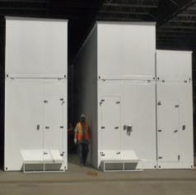

Microsoft On The Internet
400m active accounts
1.0
One of 3rd world’s largest private networks
More than 3 billion queries
per month
1 billion+ authentications per day
Microsoft
account
1.0
750 million unique visitors
at any given time
Global Foundation
Services
To achieve this look
Insert BAR CHART
Draw Rectangles on top individual bars in chart to replicated bar
Add numbers / Text Box in rectangle
Delete or hide chart

Slide 6
Windows Azure
By the Numbers

Slide 7





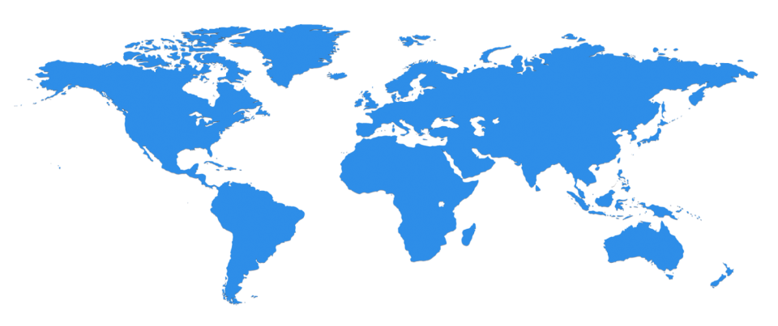

The Microsoft Cloud
~100 Globally Distributed Data Centers
Quincy, WA
Chicago, IL
San Antonio, TX
Dublin, Ireland
Generation 4 DCs

Slide 8
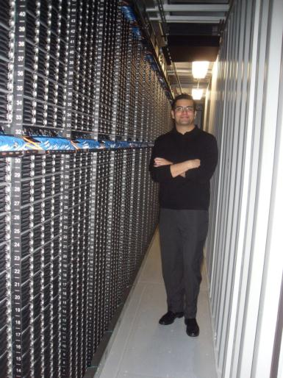
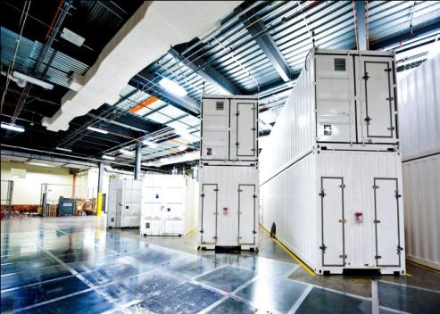

Inside a Microsoft Data Center

Slide 9








The Windows Azure Platform
Azure GA
Azure Preview
Client Layer
Office SharePoint
PC
Tablet
Phone
Browser
Games Console
On-premises Service
On-premises Database
Integration Layer
CDN
Traffic Manager
Virtual Network
Load Balancer
Connect
EAI / EDI
Service Bus
AD Access Control
SQL Data Sync
Service Layer
Cloud Services
Media Services
Hadoop
Web Sites
Web/Worker
Virtual Machines
Storage
SQL
Data Layer
Drive
Blobs
Tables
Queues
Caching
Stream Insight
SQL Reporting
SQL Database

Slide 10
Cloud Services
You Manage
You Manage
You Manage
You Manage
On Premises
Infrastructure
(as a Service)
Platform
(as a Service)
Software
(as a Service)
Vendor Manages
Vendor Manages
Vendor Manages
Applications
Applications
Applications
Applications
Data
Data
Data
Data
Runtime
Runtime
Runtime
Runtime
Middleware
Middleware
Middleware
Middleware
O/S
O/S
O/S
O/S
Virtualization
Virtualization
Virtualization
Virtualization
Servers
Servers
Servers
Servers
Storage
Storage
Storage
Storage
Networking
Networking
Networking
Networking
Notes:
Slide Objectives:
Explain the differences and relationship between IaaS, PaaS, and SaaS in more detail.
Speaking Points:
Here’s another way to look at the cloud services taxonomy and how this taxonomy maps to the components in an IT infrastructure.
Packaged Software
With packaged software a customer would be responsible for managing the entire stack – ranging from the network connectivity to the applications.
IaaS
With Infrastructure as a Service, the lower levels of the stack are managed by a vendor. Some of these components can be provided by traditional hosters – in fact most of them have moved to having a virtualized offering.
Very few actually provide an OS
The customer is still responsible for managing the OS through the Applications.
For the developer, an obvious benefit with IaaS is that it frees the developer from many concerns when provisioning physical or virtual machines.
This was one of the earliest and primary use cases for Amazon Web Services Elastic Cloud Compute (EC2).
Developers were able to readily provision virtual machines (AMIs) on EC2, develop and test solutions and, often, run the results ‘in production’.
The only requirement was a credit card to pay for the services.
PaaS
With Platform as a Service, everything from the network connectivity through the runtime is provided and managed by the platform vendor.
The Windows Azure best fits in this category today.
In fact because we don’t provide access to the underlying virtualization or operating system today, we’re often referred to as not providing IaaS.
PaaS offerings further reduce the developer burden by additionally supporting the platform runtime and related application services.
With PaaS, the developer can, almost immediately, begin creating the business logic for an application.
Potentially, the increases in productivity are considerable and, because the hardware and operational aspects of the cloud platform are also managed by the cloud platform provider, applications can quickly be taken from an idea to reality very quickly.
SaaS
Finally, with SaaS, a vendor provides the application and abstracts you from all of the underlying components.

Slide 11






Virtual Machines
Scalable on-demand infrastructure in the cloud
Growing list of validated & Microsoft supported workloads
Secure private network connection to on-premises
Connect with on-premises Active Directory and domains
Use what you know, manage with System Center
Integrates with Windows Azure app, data and storage services
Windows Server
Linux
your app in the public cloud
VHD
Virtual Network
Your data center
Windows Azure
Notes:
Let’s start by taking a look at the components that make up Infrastructure Services on Windows Azure.
Windows Azure Virtual Machines is how you get compute power – servers that scale on-demand in the cloud. You can choose Windows Server and Linux operating systems in multiple configurations. Virtual Machines gives your applications and systems full mobility, so you can move virtual hard disks (or VHDs) back and forth between on-premises and the cloud. To move your applications to Virtual Machines, to the public cloud, in most cases , you don’t have to make any changes at all. If your app works on Hyper-V, it works on Virtual Machines. This gives you the option of bringing existing applications to cloud with no code changes.
Then, we have storage attached to your images running in Virtual Machines. Windows Azure Blob storage powers it to give you six copies of the disk image you’re running. 3 in the data center you are in, and 3 in another data center hundreds of miles apart. That is geo-redundant storage for your images at no additional charges beyond compute which enables durability for your images and disks running in Virtual Machines.
Windows Azure Virtual Network enables you to securely connect your cloud infrastructure and cloud apps to your on-premises data center using a private connection over IPsec. This is important when there are applications, data and resources you want to retain on-premises, such as your identity store Active Directory, or apps with data processing back-ends on-premises and customer-facing web front-ends in the cloud. Virtual Network provides connectivity to data and applications on-premises, including systems running on Windows Server, mainframes and UNIX. It’s a security enhanced and logical private network connection.
Virtual Network and Virtual Machines work together to enable you to meet your growing infrastructure needs in the cloud. Whether you need to build on-premises connected hybrid cloud architectures or just purely use public cloud, infrastructure services on Windows Azure deliver.
Now, we are going to dive deeper into Virtual Machines and Virtual Networks and look under the hood. Be ready, we are about to look under the hood to study the technology building blocks. These building blocks enable the scenarios we will cover later on.

Slide 12
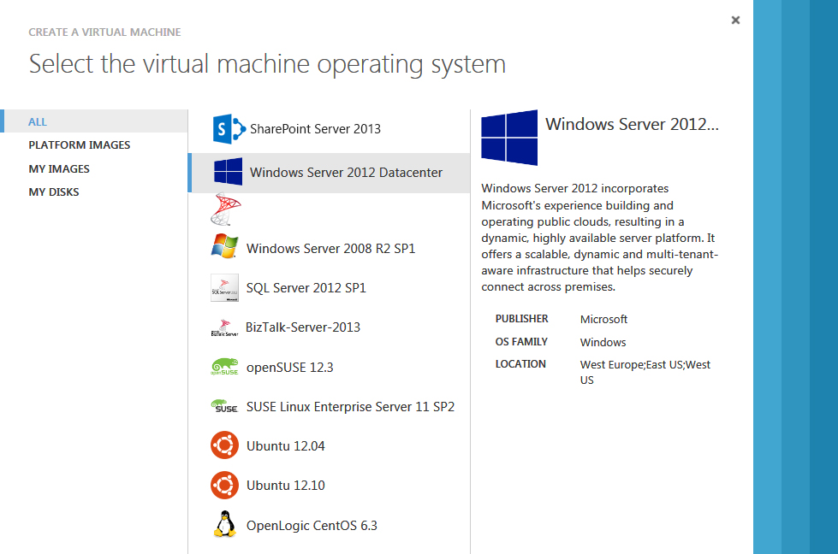

Getting Started with Virtual Machines
Multiple options to get started…
Management Portal
>_
Scripting
(Windows, Linux and Mac)
REST API
Notes:
How do you start? That is the first question we will address for you.
For those of you who are new to Virtual Machines and who need an easy and quick way to get started, Windows Azure Management portal, the web interface, offers the desired experience. Simply provision Virtual Machines from the Image Gallery in minutes . Virtual Machines Image Gallery contains pre-built images of Linux – CentOS, Ubuntu and Suse Enterprise Linux (SLES), Windows Server, SQL Server, SharePoint (evaluation copy) and BizTalk Server. These images have hourly rates, where you pay for what you use. We are continuously working on expanding the images in the gallery – both for most popular Microsoft workloads but also for prebuilt Linux images from commercial distributors.
On the other hand, some of you will be familiar with Virtual Machines having used it since the preview. And, you might be looking for ways to automate tasks like provisioning virtual machines or building workflows for your organization where you upload a large number of custom images into your storage account. REST based service management APIs and PowerShell commands are the tools you use in that case.

Slide 13


How it Works Select from Image Gallery
Log in to
Windows Azure
Management Portal
Create new VM from image gallery
The image is copied to
your blob storage account
Virtual Machine booted. Changes direct-write to blob storage
Notes:
We talked about getting started from the Virtual Machines Image Gallery. What happens when you select an image from the gallery? The image is copied to your blob storage account and then your virtual machine is booted with that image. From there on, any changes you make to the image are directly written into the blob storage and persisted. This is also where the storage element we talked about in infrastructure services come into play.
Microsoft will be maintain and keep the images fresh and up to date when you choose an image from the Image Gallery.

Slide 14

How it Works Bring your own custom VHD
Create your own VHD
Upload image to blob storage
Create a Virtual Machine by attaching to disk
Virtual Machine booted. Changes direct-write to blob storage
Notes:
You have more options than using just the images in the Virtual Machine Image Gallery. When you have custom images created in VHD format using Hyper-V, you can easily bring them into Windows Azure as well. These images can simply be your favorite Linux stacks obtained from VM Depot, images for existing applications running on-premises or images with Microsoft server workloads such as SharePoint that you need to build your collaboration environments. Simply upload to blob storage – you can do that using PowerShell commands and then create your disks using the image in the management portal. Voila , your Virtual Machine is booted with the right pieces in it.
In this case, you have the full option and control of maintaining and updating your image as it fits your needs.

Slide 15
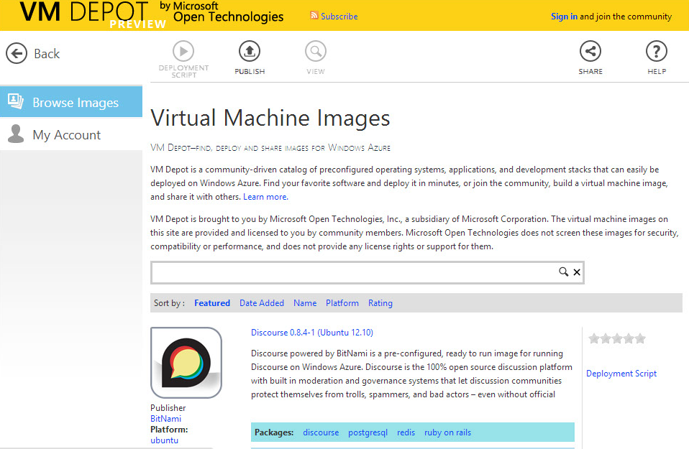
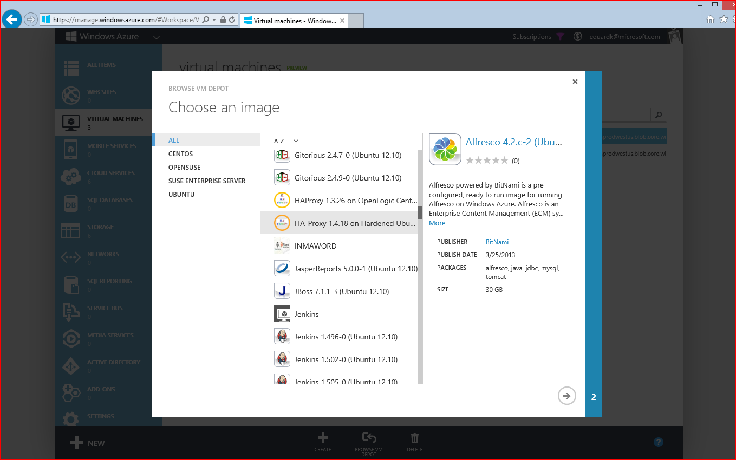
Working with Open Source
Growing gallery of open source Linux images
Licensed & supported by the community
Integrated with Windows Azure Management Portal for easy deployment
Notes:
Let us also talk about VM Depot, by Microsoft Open Technologies, which is a community gallery of open source Linux images. VM Depot images are licensed, managed and supported by the open source community. You can find your most favorite Linux flavors in VM Depot along with applications running on top. This is another option for customers with heterogeneous environments and variety of stacks.
VM Depot connects directly into Windows Azure Management Portal and users can provision VM Depot images in the portal. It is important for us to note that VM Depot images are supported and maintained by the open source community through forums and not by Microsoft’s Customer Support organization.

Slide 16
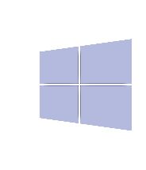


Open to All Apps
Microsoft® Virtual Machine Converter
PowerShell
VMDK
VHD
VMware® vCenter™
vSphere Hypervisor™
Windows
Hyper-V Hypervisor
Windows Azure Virtual Machines
Notes:
We can take the openness and heterogeneity concept further. Many of you might have existing workloads and apps that are virtualized with VMware which would be in VMDK virtualization format. When you are ready to bring those applications to Windows Azure, so that you free up on-premises datacenter capacity or simply run those apps on modern infrastructure, you have options.
If you are a System Center user, you can convert your VMDK images into VHD format using and then bring them on to Windows Azure Virtual Machines. (More info here: http://technet.microsoft.com/en-us/library/bb963721.aspx)
Yet, this is not the only approach. We also offer a free downloadable utility called Microsoft Virtual Machine Converter which will take VMDK images and convert them into the VHD format. You can then use PowerShell scripts in uploading those images into Virtual Machines and get going! (More information is here: http://technet.microsoft.com/en-us/library/hh967435.aspx)
Whether you start with the gallery or with a custom image, whether you start with Windows Server or Linux or VMware, you have a robust foundation in Virtual Machines and flexible options to get there.

Slide 17




Persistent Virtual Machines with Geo-Replication
Windows Azure Storage
Notes:
Another very important attribute of Windows Azure Virtual Machines is the fact that they are persistent. That means the state of your Virtual Machine is saved and stored. When you stop your instances and restart later on, your settings and configurations persist and carry forward. When you restart your machine, your settings and configurations persist and carry forward.

Slide 18

Persistent Virtual Machines with Geo-Replication
Windows Azure Storage
Notes:
In the same context, we need to talk about the geo-replication concept. It is a unique durability benefit Virtual Machines users get on Windows Azure. It means you get 6 total copies of your image redundantly replicated.
First, every Windows Azure Virtual Machine image is replicated 3 times within the region you are running in. This provides high availability, so if a rack or a storage server were to be down, you still enjoy high availability. You would get a new instance up and running behind the scenes. In addition, since these are persistent Virtual Machines, your new image would have the exact same state and configuration.

Slide 19
Persistent Virtual Machines with Geo-Replication
WEST
DC
EAST
DC
> hundreds of miles
continuous storage geo-replication
Windows Azure Storage
Notes:
Second, your image is asynchronously copied to another datacenter that’s hundreds of miles away. These two elements are what we call geo-replication. Geo replication is a unique feature, that differentiates us. Virtual Machine users get that by default. On other cloud platforms, it requires a deliberate effort to capture and image and to store it and then to replicate it across regions.
Geo-replication also is key to disaster recovery. Since the images are stored in datacenters hundreds of miles apart redundantly, you can have the peace of mind that you can go to these redundantly stored copies and bring them up in case of natural disasters.

Slide 20

Flexibility & Portability
Windows Azure
Other Service Providers
VHD
VHD
VHD
VHD
VHD
VHD
VHD
VHD
Your Data Center
VHD
VHD
VHD
Notes:
If you are like most other customers, you will be asking if you are locked into the decision to use public cloud and what options you might be giving up when you use Windows Azure Virtual Machines.
That is pretty straightforward to answer. Since the underlying virtualization format is VHD, and the virtualization layer is Hyper-V, your apps and your images can move in and out of Windows Azure and the public cloud. You can start with your app prototypes in the cloud and then move to on-premises when ready or simply move to a hosting partner’s datacenter – if so you choose. This is all about flexibility and having options and not being locked-in.

Slide 21
Cloud Storage
Blobs
Simple named files along with metadata for the file.
Tables
Structured storage. A table is a set of entities; an entity is a set of properties.
Queues
Reliable storage and delivery of messages for an application.
SQL Database
Reliable storage and delivery of messages for an application.

Slide 22
Focused CiS Applications & Workloads
Target Use Cases
File Share
File servers
NAS
CIFS
NFS
Archives
Media
Engineering
Logs, Records
EMR / PACS
Legal
Construction
Capacity
CapEx, OpEx of traditional storage
Cloud Storage
Data grows exponentially (50-60% annually)
CapEx, OpEx of StorSimple
SharePoint
Collaboration
Content & records mgmt
Business intell.
VMs
VM sprawl
Regional office storage
VM archives
Local Storage
Time
However, most I/O happens to the “Working Set” data

Slide 23
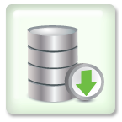

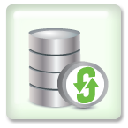


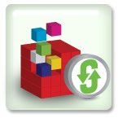


StorSimple Architecture: Life of an IO
SSD
Linear Tier
High Performance
A
B
C
A
B
D
E
SSD Deduplicated
Increase Efficiency
E
SAS
Deduplicated
Compressed
High Capacity
C
D
E
Cloud
Deduplicated
Compressed
Encrypted
Cost Savings
D
E
A
B
C
E

Slide 24
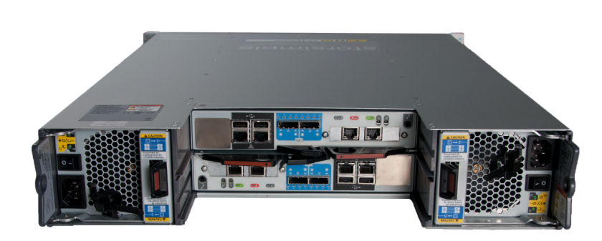
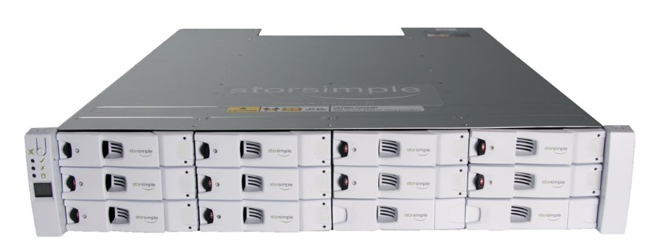
StorSimple Enterprise Class Appliance Highly Available - No Single Point of Failure
1. Full MPIO Support
2. Dual Controllers with Auto-failover
3. Dual Power
4. Dual Cooling
5. RAID drives
6. Hot-spare drives
7. Non-disruptive software upgrades
8. Certified by Microsoft & VMWare

Slide 25





Media Services
Your Choice of Components for Building Custom Media Workflows in the Cloud
Windows Azure Media Services
Ingestion
Encoding
Format Conversion
Content Protection
On-Demand
Streaming
Live
Streaming
Analytics
Advertising
Notes:
By “Media Services”, we mean a collection of components and technologies from Microsoft and third parties that are curated, ready-to-use, and integrated into a single platform to simplify the creation of end-to-end media solutions.

Slide 26










Media Services Architecture
Client Libraries
“Build-On” Media Partners and Customers
Windows 8
Partner CDNs
Silverlight
REST APIs
Azure Media Services Components
Windows Phone
Secure
Media Ingest
Encoding
On-Demand
Origin
Live Ingest
Live Origin
Ad Insertion
Xbox
HTML5
Media Job
Scheduling
“Build-In”
Partner Media Processors
Content Protection
Live Encoding
Analytics
Identity Management
Azure CDN
Flash
Windows Azure Core Platform
Adaptive Streaming
Porting Kits
(STB, iOS / Android)
Origin
Caching

Slide 27
2012 London Olympics
17 days of broadcast starting July 25th
First major event broadcast live from the cloud
Content Management by deltatre via Windows Azure Media Services and CDN delivery by Akamai
Major platform support: Web and Mobile
Silverlight, iOS, Windows Phone 7, Android
28 channels in Dublin, 5 in Chicago, 2 for South America
Each channel has backup channel
Over 2200 hours of broadcast video with DVR and Video-On-Demand support
500 VMs and 3000 cores
Highlight reel and real-time voice-over support

Slide 28


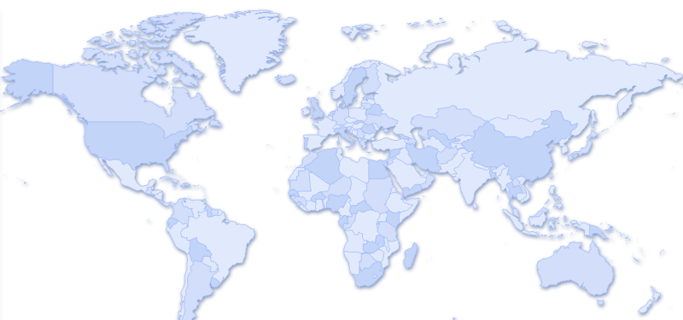
SQL Database
compute
data management
networking
cloud services
VMs
websites
SQL database
noSQL database
blob
connect
virtual network
traffic manager
Single Logical Database
Multiple Physical Replicas
Replica 1
Cloud relational database based on SQL Server engine
Use same tools, data access frameworks, T-SQL based language
Global datacenters
High Availability & Redundancy
Reads are completed at the primary
Writes are replicated to a quorum of secondaries
Replica 2
Multiple Secondaries
Single Primary
Replica 3
Notes:
Quickly create elastic applications on fully managed platform with existing skills.
Key platform capabilities:
150GB size and competitive pricing
Build, extend or migrate applications across environments using the tools you choose.
High level of interoperability and connectivity.
Flexible across on-premises and cloud.
Built on standard relational principles and practices.
Key platform capabilities:
Works with .NET, Java, PHP, Ruby on Rails and Node.js
SQL Azure Data Sync
SQL Azure spatial data support
Key platform capabilities:
SQL Azure Federation
99.9% monthly SLA and built-in high availability
SQL Azure Reporting

Slide 29
SQL Data Sync
compute
data management
networking
cloud services
VMs
websites
SQL database
noSQL database
blob
connect
virtual network
traffic manager
Application
On-Premises
Cloud
SQL Database
Application
Geo-located web applications
Use with Windows Azure Traffic Manager
Hybrid applications; one-way publish or two-way sharing
Application
Application
SQL Server
Multiple locations (e.g. branch office, retail offices); share data between locations and/or aggregate data in cloud
Application
SQL Database
SQL Database
Application
Scale-out via multiple copies of data
E.g. Separate reporting & OLTP workloads; multiple Web sites
SQL Server
SQL Database

Slide 30
Serve Demo

Slide 31
Account Setup Methodology
Choosing the right account set up methodology for your organization is an important first step in setting up your Accounts. How you set up your Accounts and Subscriptions will impact how they are administered and how they are reflected on your enterprise level reports. Examples of typical set up methodologies include structuring by:
Functional Teams Research, Education, etc.
Geographic Locations Universities, K12, etc.
Educational Divisions Universities, Colleges, K12, etc.
Applications Application 1, Application 2, etc.
Functional
Educational Division
Geographic
LAR
LAR
LAR
Research
Education
U Michigan
Stanford Medical
CENIC
Kentucky DOE
Account
Account
Account
Stanford
Michigan
Kentucky DOE
Med School
Engineering2
Hospital
UCLA
K12
Ballard County
Subscription
Subscription
Subscription

Slide 32
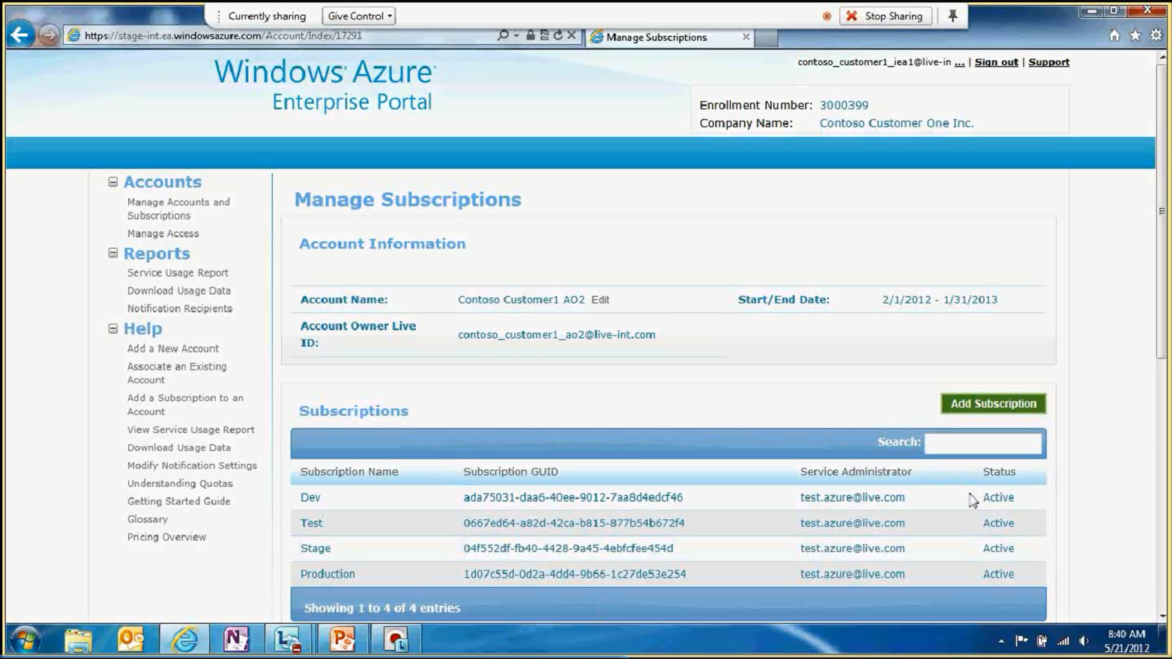
Windows Azure Education Administration Portal

Slide 33
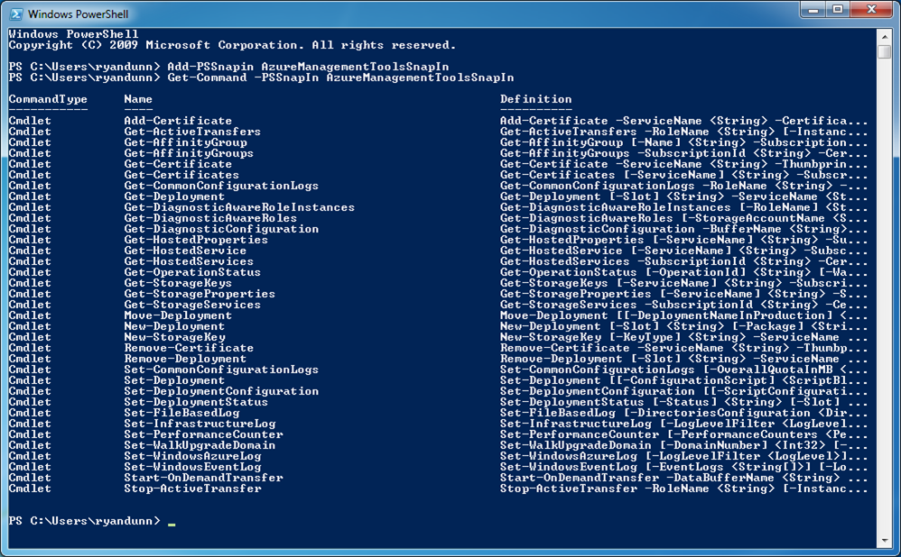
Service Management API for Managing and Monitoring Applications in Windows Azure
Provides programmatic access to platform functionality
Used to deploy, manage, and monitor applications
Powerful REST API, performed over SSL and mutually authenticated using X.509 certificates
May be accessed from within application running in Windows Azure, or directly over the Internet from any application
PowerShell commands using the same APIs can be used to script management functions
Notes:
Application in Windows Azure can be monitored and managed by using Service API’s
Service Management API
Provide programmatic access to platform functionality
Used to deploy, manage, and monitor applications
Powerful REST API, performed over SSL and mutually authenticated using X.509 certificates
May be accessed from within application running in Windows Azure, or directly over the Internet from any application
PowerShell commands using the same APIs can be used to script management functions
We can also manage and monitor Applications on Windows Azure using System center which is explained in detail in subsequent slides..

Slide 34


Windows Azure Cross-Premises Connectivity
CLOUD
ENTERPRISE
Data Synchronization
SQL Azure Data Sync
Application-Layer
Connectivity & Messaging
Service Bus
Secure Machine-to-Machine Connectivity Windows Azure Connect
Secure Site-to-Site
Network Connectivity
Virtual Network
Notes:
To enable cross premises connectivity for Hybrid IT Windows Azure provides
Windows Azure Connect: Granular control over connectivity – “machine to machine”.
Best for simple, scoped connectivity
Easy agent-based installation, set up within minutes
Works through firewall
Site to site with Virtual Networks Virtual Network allows enterprises to securely extend their on-premise networks into Windows Azure with complete control over network topology.
Provides control, set up and configuration similar to traditional VPN
Allows to bring your IP addresses, DNS etc. to the Cloud
Currently, the IPSec tunnel is through internet
Scalable “Site to site” connectivity
Application layer connectivity with ‘Messaging’ complete message based infrastructure supporting multiple messaging patterns to connect applications and systems in real-time between Windows Azure and on-premise systems. Messaging provides out-of-the-box support for various messaging patterns that enable to easily connect applications
Data Synchronization using SQL Data Sync enables easy migration, export and ongoing synchronization of on-premises SQL Server databases with Windows Azure databases.

Slide 35
Windows Azure Compliance Capabilities
Program | Description | Status
EU-US Safe Harbor Framework | Legal transfer of data to Microsoft from within EU | Complete
ISO27001 | Broad international information security standard | Complete (for core services)
SAS 70 | US accounting audit standard | Replaced by SSAE 16
SSAE 16 (SOC 1 Type 2) | Replacement for SAS 70 Type 2 | ETA mid CY2012 (for core services)
FISMA / FedRAMP | Required by law for US Federal agencies and looked on favorably by other government agencies | In progress
EU Model Clauses | Robust commitment for handling EU personal data and transfer to US | Complete (for core services)
HIPAA BAA | Protected health information in the US | ETA Q2 CY2012 (for core services)
FISMA
ISO
SSAE
HIPAA
Core Services: Compute, Storage, Virtual Network, Virtual Machine
Notes:
Windows Azure Core Services:
Compute (includes Web, Worker, and VM roles)
Storage (includes Blobs, Queues, and Tables)
Virtual Network (includes Traffic Manager and Connect)
Included in the above are our service management features and the management portal, as well as the information management systems used to monitor, operate, and update these services.
EU-US Safe Harbor Framework
Microsoft (including, for this purpose, all of our U.S. subsidiaries) is Safe Harbor certified with the U.S. Department of Commerce.
This allows for legal transfer of data to Microsoft for processing from within European Union and countries with aligned data protection laws.
Microsoft acts as the data processor and, to the extent of the Service’s capabilities, decisions regarding data usage are made by the data controller.
ISO 27001
Received ISO/IEC 27001:2005 certificate from BSI on 11/29/2011 for Windows Azure Core Services
Broad international information security standard. Acts as security baseline.
Ability to clearly demonstrate that we have achieved a baseline certification.
Gets our compliance team building a rigorous security compliance framework that can then be expanded upon – documentation and process heavy with some technical gaps to close.
The ISO/IEC 27001:2005 certificate validates that Microsoft has implemented the internationally recognized information security controls defined in this standard.
SSAE 16
Successor to SAS 70 attestations.
An accounting standard that is relied upon as the authoritative guidance for reporting on service organizations.
It illustrates Microsoft’s willingness to open up internal security programs to outside scrutiny.
The end result is auditor’s report on the effectiveness and suitability of selected controls to achieve desired control objectives during the period under review. Detailed SSAE 16 report can then be shared with customers under NDA.
We are currently working with Deloitte to define a set of controls that will be monitored in H2. We expect to have the audit report available for Windows Azure core services by mid CY2012.
EU Data Protection Directive
Law that sets a baseline for handling Personally Identifiable Information (PII) in the EU
US standards meet EU requirements through US Safe Harbor
Microsoft self-attests compliance under the US Safe Harbor framework, which lets us transfer EU PII outside EU, and even allows the “onward-transfer” from the US to another country
However, EU regulators and customers increasingly consider the Safe Harbor to be inadequate and are asking for EU Model Contractual Clauses, which we don’t currently sign. Having completed ISO 27001 for WA Core Services, we expect to be able to sign EU Model Clauses for WA Core Services in Q1 CY2012.
Geolocation of Data
Clarifies that we don’t transfer EU data outside of EU data centers except in extraordinary circumstances
Customers may specify the geographic region(s) of the Microsoft datacenters in which Customer Data will be stored.
For data redundancy or other purposes, Microsoft may move Customer Data within a major geographic region (for example, between West Europe and North Europe), but Microsoft will not move Customer Data outside the major geographic region(s) customer specifies (for example, from Europe to US or from US to Asia) except where the customer configures the account to enable this (for example, through use of the Content Delivery Network feature).
Microsoft may, however, access Customer Data from outside such region(s) where necessary for Microsoft to provide customer support, to troubleshoot the service, or to comply with legal requirements. Such transfers will be done pursuant to EU-US Safe Harbor Framework.
Microsoft does not control or limit the regions from which customers or their end users may access Customer Data.
Health Insurance Portability and Accountability Act (HIPAA)
Specifies privacy, security, and disaster recovery guidelines for electronic storage of health records.
No platform can be HIPAA compliant; what is needed, though, is Business Associate Agreement (BAA) that enables third parties to build HIPAA compliant applications on Windows Azure. We need to sign a BAA with the Covered Entity if Protected Health Information (PHI) they are responsible for is to be stored, processed or otherwise accessed by Azure
Substantial overlap with ISO controls, i.e., HIPAA program will benefit substantially from ISO work
Gap analysis nearly complete, expected to offer BAA in Q2 CY2012
Microsoft has significant investments in HealthVault and Amalga – HIPAA is one of the biggest industry-specific opportunities to unblock. Portions of HealthVault run on Azure today (not the entire solution, though).
Payment Card Industry Data Security Standard
Requires annual review and validation of security controls related to credit card transactions.
There is an audited service provider certification that we need to get in order to store, process or otherwise access credit card information
Credit card info cannot be stored or processed on Azure. We can process our customers’ credit cards because that’s done on a separate PCI-compliant back-end separate from Azure.
Many third parties can handle payment processing for Azure apps using off platform payment processors. However, this approach complicates the app and typically degrades the end user experience so our customers want on-platform processing.
The latest standard (2.0) supports fully virtualization and multi-tenancy.
Some work to be completed as part of ISO/SSAE first. Figure out the delta relative to ISO/SSAE first.
FISMA
Federal Information Security Management Act of 2002 (FISMA) is a U.S. federal law that defines a comprehensive framework to protect government information, operations, and assets against natural and man-made threats
Required by law for U.S. federal agencies, and looked on favorably by other government agencies
The law gives National Institute of Standards and Technology (NIST) authority to establish standards that are not product and technology specific
Very strong security standard
We are committed to obtaining FISMA Moderate Authorization to Operate (ATO)
Sponsoring agency General Services Administration (GSA)
Build on top of ISO/SSAE work, and remediate controls where needed to much stricter FISMA standards
Engineering gap analysis completed
Timeline to be established once engineering plan is in place

Slide 36
Cloud Computing Patterns
On and Off – Start/End Semester
Inactivity
Period
On & off workloads (e.g. batch job)
Over provisioned capacity is wasted
Time to market can be cumbersome
Compute
t
Growing Fast – Research Project
Compute
Successful services needs to grow/scale
Keeping up w/ growth is big IT challenge
Cannot provision hardware fast enough
t
Unpredictable Bursting – Web demand
Compute
Unexpected/unplanned peak in demand
Sudden spike impacts performance
Can’t over provision for extreme cases
t
Predictable Burst – Registration
Compute
Services with micro seasonality trends
Peaks due to periodic increased demand
IT complexity and wasted capacity
t

Slide 37
Instance Counts
While limiting the amount of VMs you have running is a good way to save costs you need at least two instances for SLA, availability and load balancing
Use dynamic scaling to handle burst
Consider spinning down some portion of capacity during off hours (night, weekend, holiday)

Slide 38


Leverage Parallel Operations
If you’re re-selling a service hosted in Azure, you could charge premium for faster turnaround while your processing costs are the same
9am
10am
11am
12am
Job Time | Your Cost
4 hours | .48
1 hour | .48
9am

Slide 39
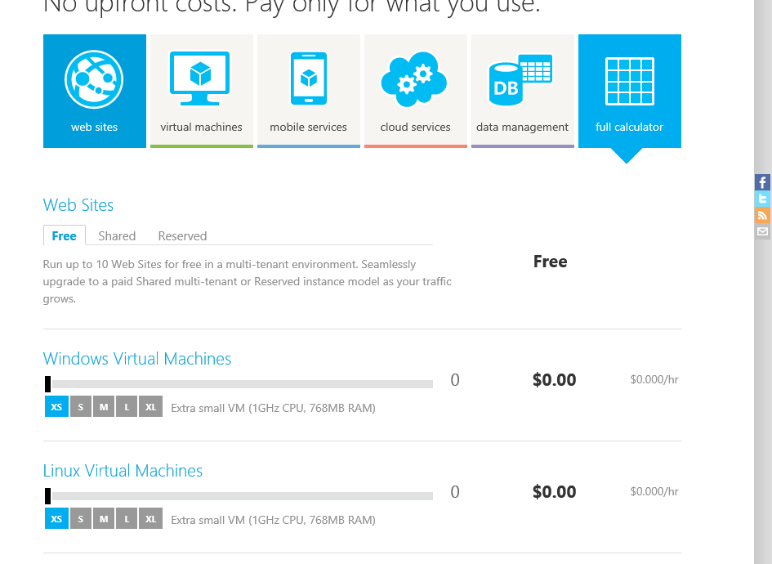

Slide 40
Customers Have Different Needs for Support
I am learning Azure and developing my 1st app
I have a production app on Azure
Growing user base using my app on Azure
I have a business critical app on Azure
I am mostly self-sufficient and occasionally need to contact support if I can’t figure out why things don’t work
I need to have skilled engineers help me troubleshoot when my application is down
My customers are less productive when our apps are down. I need to have priority access to support right away
I need a trusted advisor to mentor my developers, help me optimize my deployment, and ensure all my issues are managed with priority until resolved
Entry-level reactive
Foundational reactive
Premium reactive
Premium reactive/proactive

Slide 41
Tiered Support Offerings
Entry-level reactive
Foundational reactive
Premium reactive
Premium reactive/proactive
Free
Web $39/Month 6-month contract
Basic $300/Month 6-month contract
Pro-Direct $1K/Month 6-month contract
Premier $3K/$12K/$44K/Month 1-yr contract
Developer Mentoring & Proactive Services
App Dev Mgr (Pooled)
Azure Specific
App Dev Mgr (Designated)
All Microsoft Products
Unique Phone Line Elevated Priority
Unique Phone Line Elevated Priority
MS Exec Escalations
3 Phone Incidents per month
Unlimited Phone Incidents
Unlimited Phone Incidents
Response Time Sev B: 4 Hrs
Sev C: 8 hrs
Response Time Sev A: 2 hrs, Sev B: 4 Hrs
Sev C: 8 hrs
Response Time Sev A: 1 hrs, Sev B: 2 Hrs
Sev C: 4 hrs
Response Time Sev A: 1 hrs, Sev B: 2 Hrs
Sev C: 4 hrs
Unlimited Break/ Fix Support via Web
Unlimited Break/ Fix Support via Web
Unlimited Break/ Fix Support via Web
Unlimited Break/ Fix Support via Web
Community Forum | Service Dashboard and Outage Report | Billing and Account Support

Slide 42
How does that help me?
Storage: always running out of disk
DR: offsite storage, servers, backup
Burst: need more capacity
Media: create, store, distribute, to different devices
Lab resources: turn off at the end of the semester
Dev/test: validate apps and environments
Research: large compute, short window of need
Database: without the hassles
Collaboration repository
HIPAA: process and store private data

Slide 43

Getting Started

Slide 44
Good First Project Candidates
Simple two tier application or just the web tier of existing application
Old application that is due for rewrite
New student outreach/marketing campaign
Start with a simple, low risk project then move to progressively more challenging apps as your team’s confidence improves

Slide 45
Free 90 Day Trial
3 Month Free Trial
INCLUDES THESE SERVICES:
Compute
Storage
Transactions
Bandwidth
Databases
Caching
Access Control
Service Bus
Requires credit card at sign-up
Default $0 spending limit – no surprises

Slide 46
Free MSDN Azure Benefits
 | Ultimate | Premium | Professional
Compute | 1500 hrs of small instances | 750 hrs of small instances | 375 hrs of small instances
Storage | 30GB | 25GB | 20GB
Transactions | 4M | 2M | 1M
Bandwidth | 35GB out / free in | 30GB out / free in | 25GB out / free in
Databases | 5GB Web Edition | 1GB Web Edition | 1GB Web Edition
Access Control | 500K | 200K | 100K
Service Bus | 1M Messages 3000 Relay Hours | 1M Messages 3000 Relay Hours | 500K Messages 1500 Relay Hours
Annual Savings | $1,400 | $2,000 | $3,600

Slide 47
Educators Trial
12 Month Pass
INCLUDES THESE SERVICES:
Compute
Storage
Transactions
Bandwidth
Databases
Caching
Service Bus
Requires application for Educational Grant
Number of students in your coarse
Number of passes needed

Slide 48
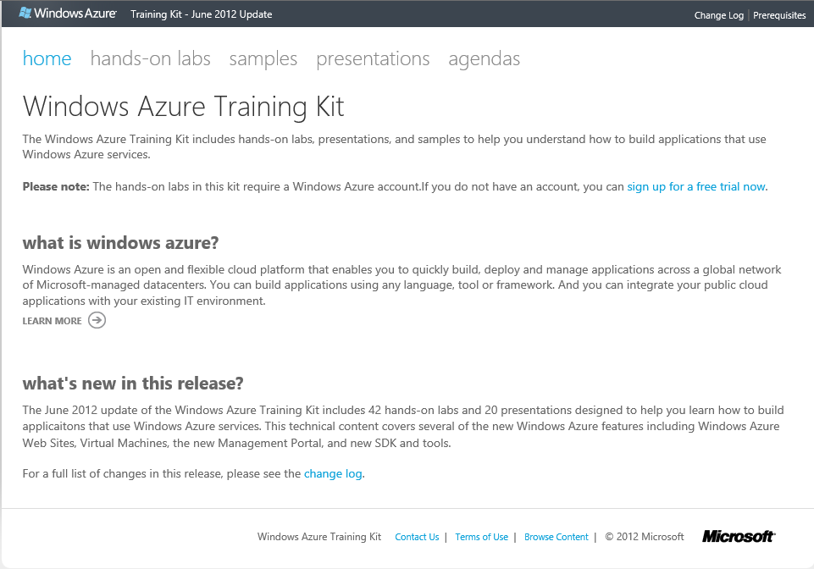
Windows Azure Training Kit (WATK)

Slide 49
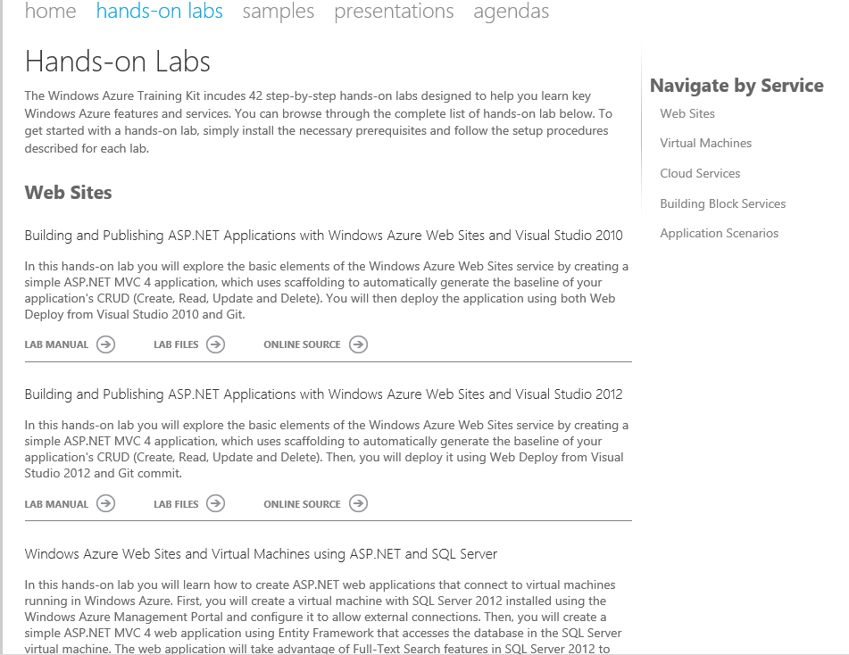

Slide 50
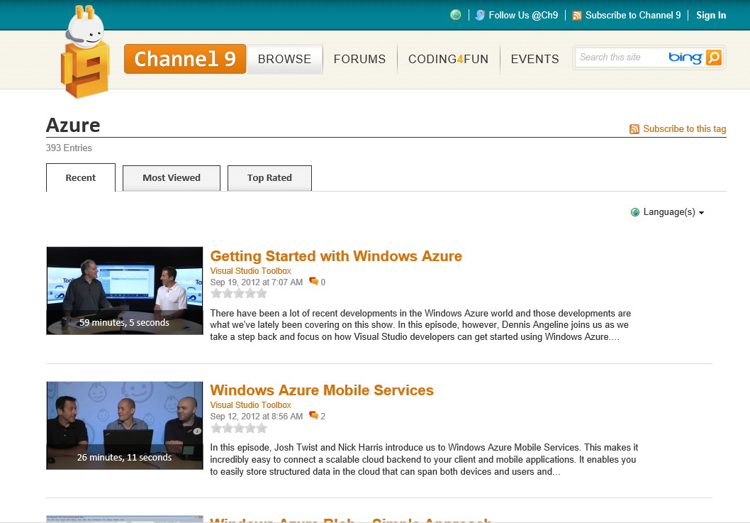

Slide 51

Summary
Windows Azure provides a comprehensive set of services that you can selectively compose to build your cloud apps
Global Data Center Footprint
99.95% Monthly SLA.
Pay only for what you use.
Flexible & Open Compute Options
Virtual Machines, Web Sites, & Cloud Services
Managed Building Block Services
SQL Database, Cache, Service Bus, & more

Slide 52


